Slide 1
Timetable Displayer
Mid defense
1

Slide 2
Presentation Topics
Project Overview
Project purpose
Project Feature
Use Case
Activity Diagram
Sequence Diagram
ERD
2

Slide 3
Project Overview
Web-based Project.
Provide Digital Solution Like: View per semester Timetable, Download PDF file, Easy to manage.
Timetable Displayer also manage the semester details.
Parameters of teachers' time, rooms, class time, etc.
Creating and maintaining.
Educational institutions play an effective role.
3

Slide 4
Project purpose
Easy to create account
Easy and view per semester class routine.
Reduce from extra hassle
Digital Solution
Easy to manage
4

Slide 5
Solution Features:
Admin
Course Teacher manage
Courses manage
Rooms manage
Periods manage
Classes manage
Generate Timetable
Download PDF file
Student
1. Account manage
2. View Timetable
- student can easily view per semester class routine.
3. Download PDF file
5

Slide 6
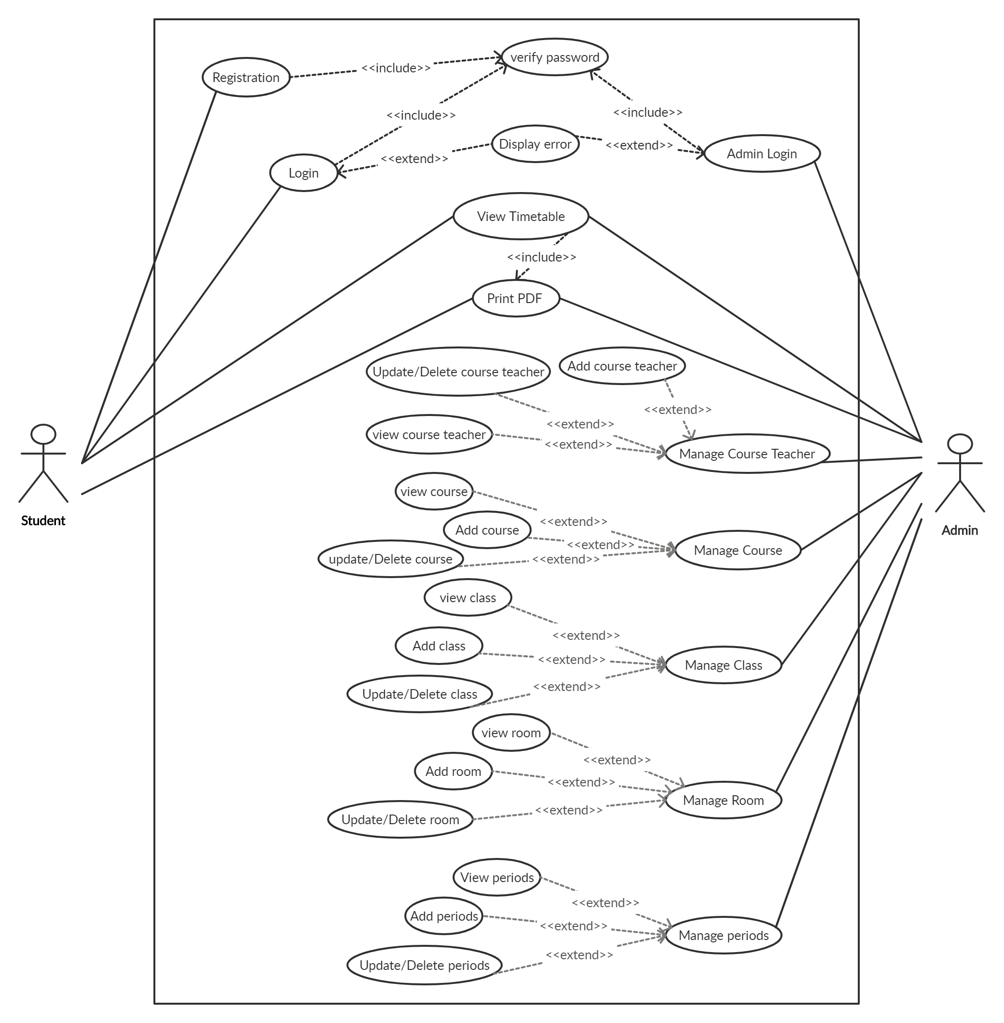
1. Use case diagram
6
1. fig: Use case diagram

Slide 7
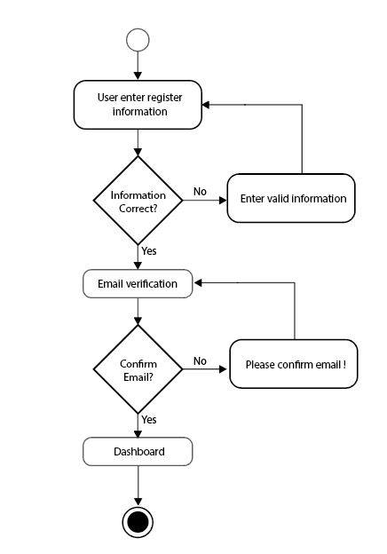
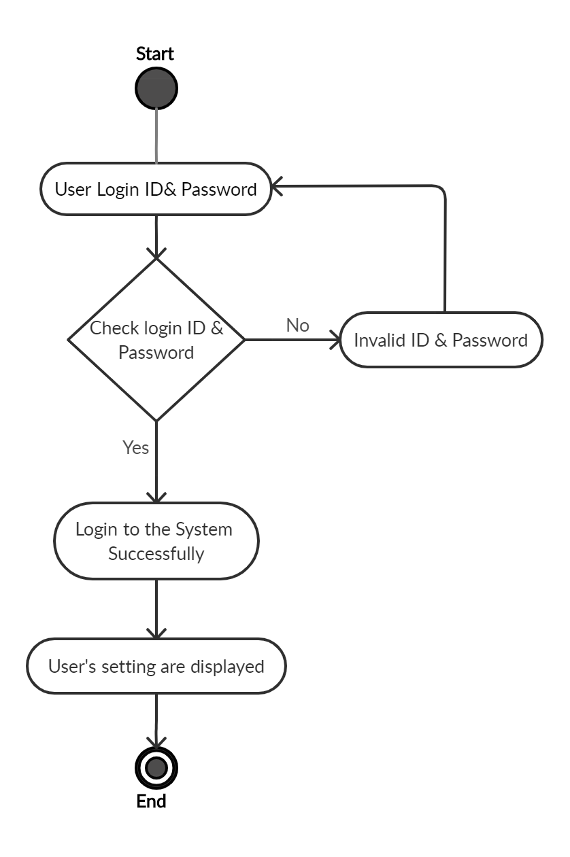
2. Activity Diagram
2.1 fig: Student Registration
2.2 fig: Student login
7

Slide 8
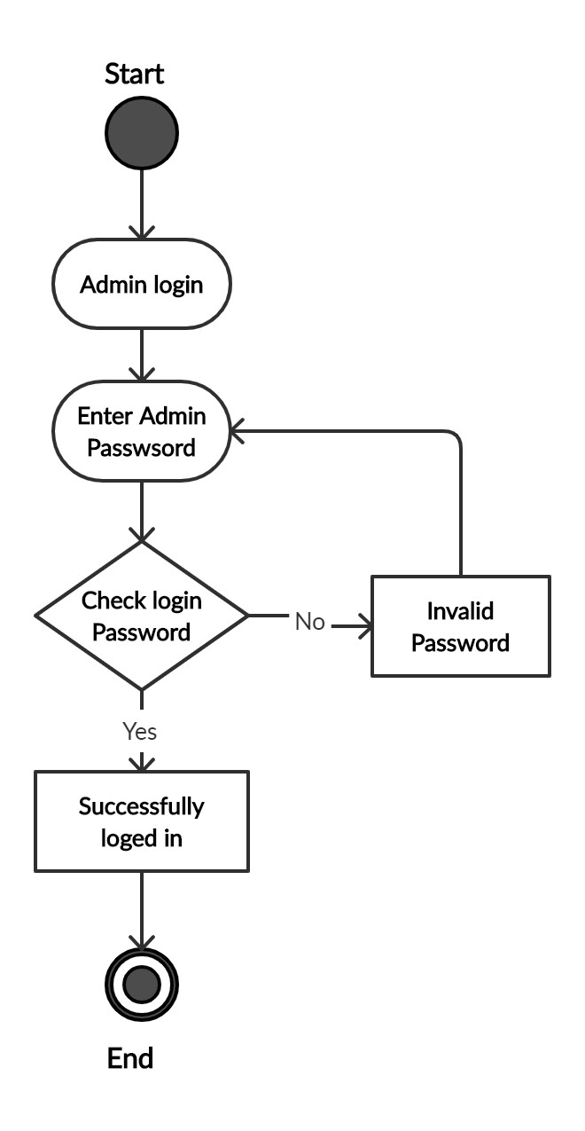
Activity Diagram
2.3 fig: Admin login
8

Slide 9
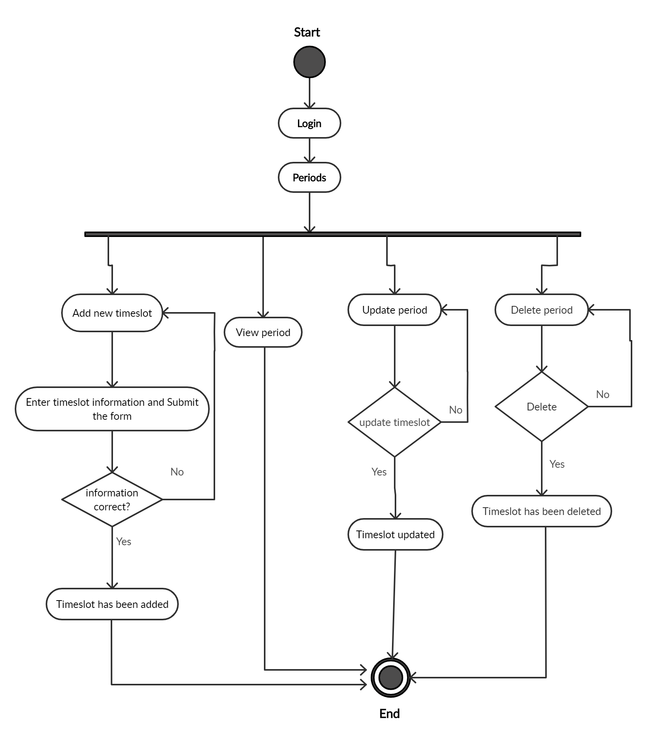
Activity Diagram
9
2.4 fig: Manage period

Slide 10
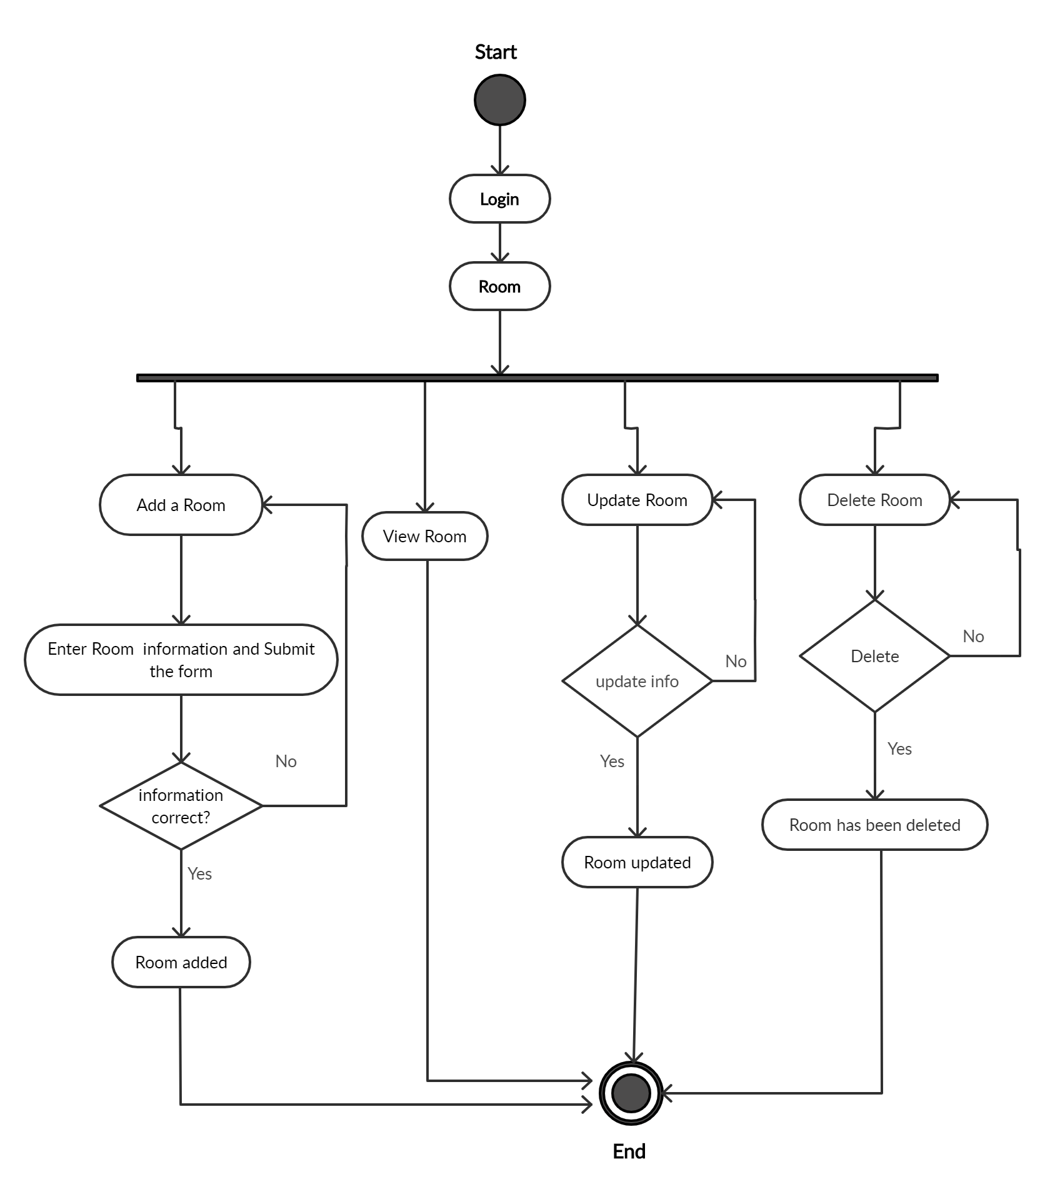
Activity Diagram
10
2.5 fig: Manage Room

Slide 11
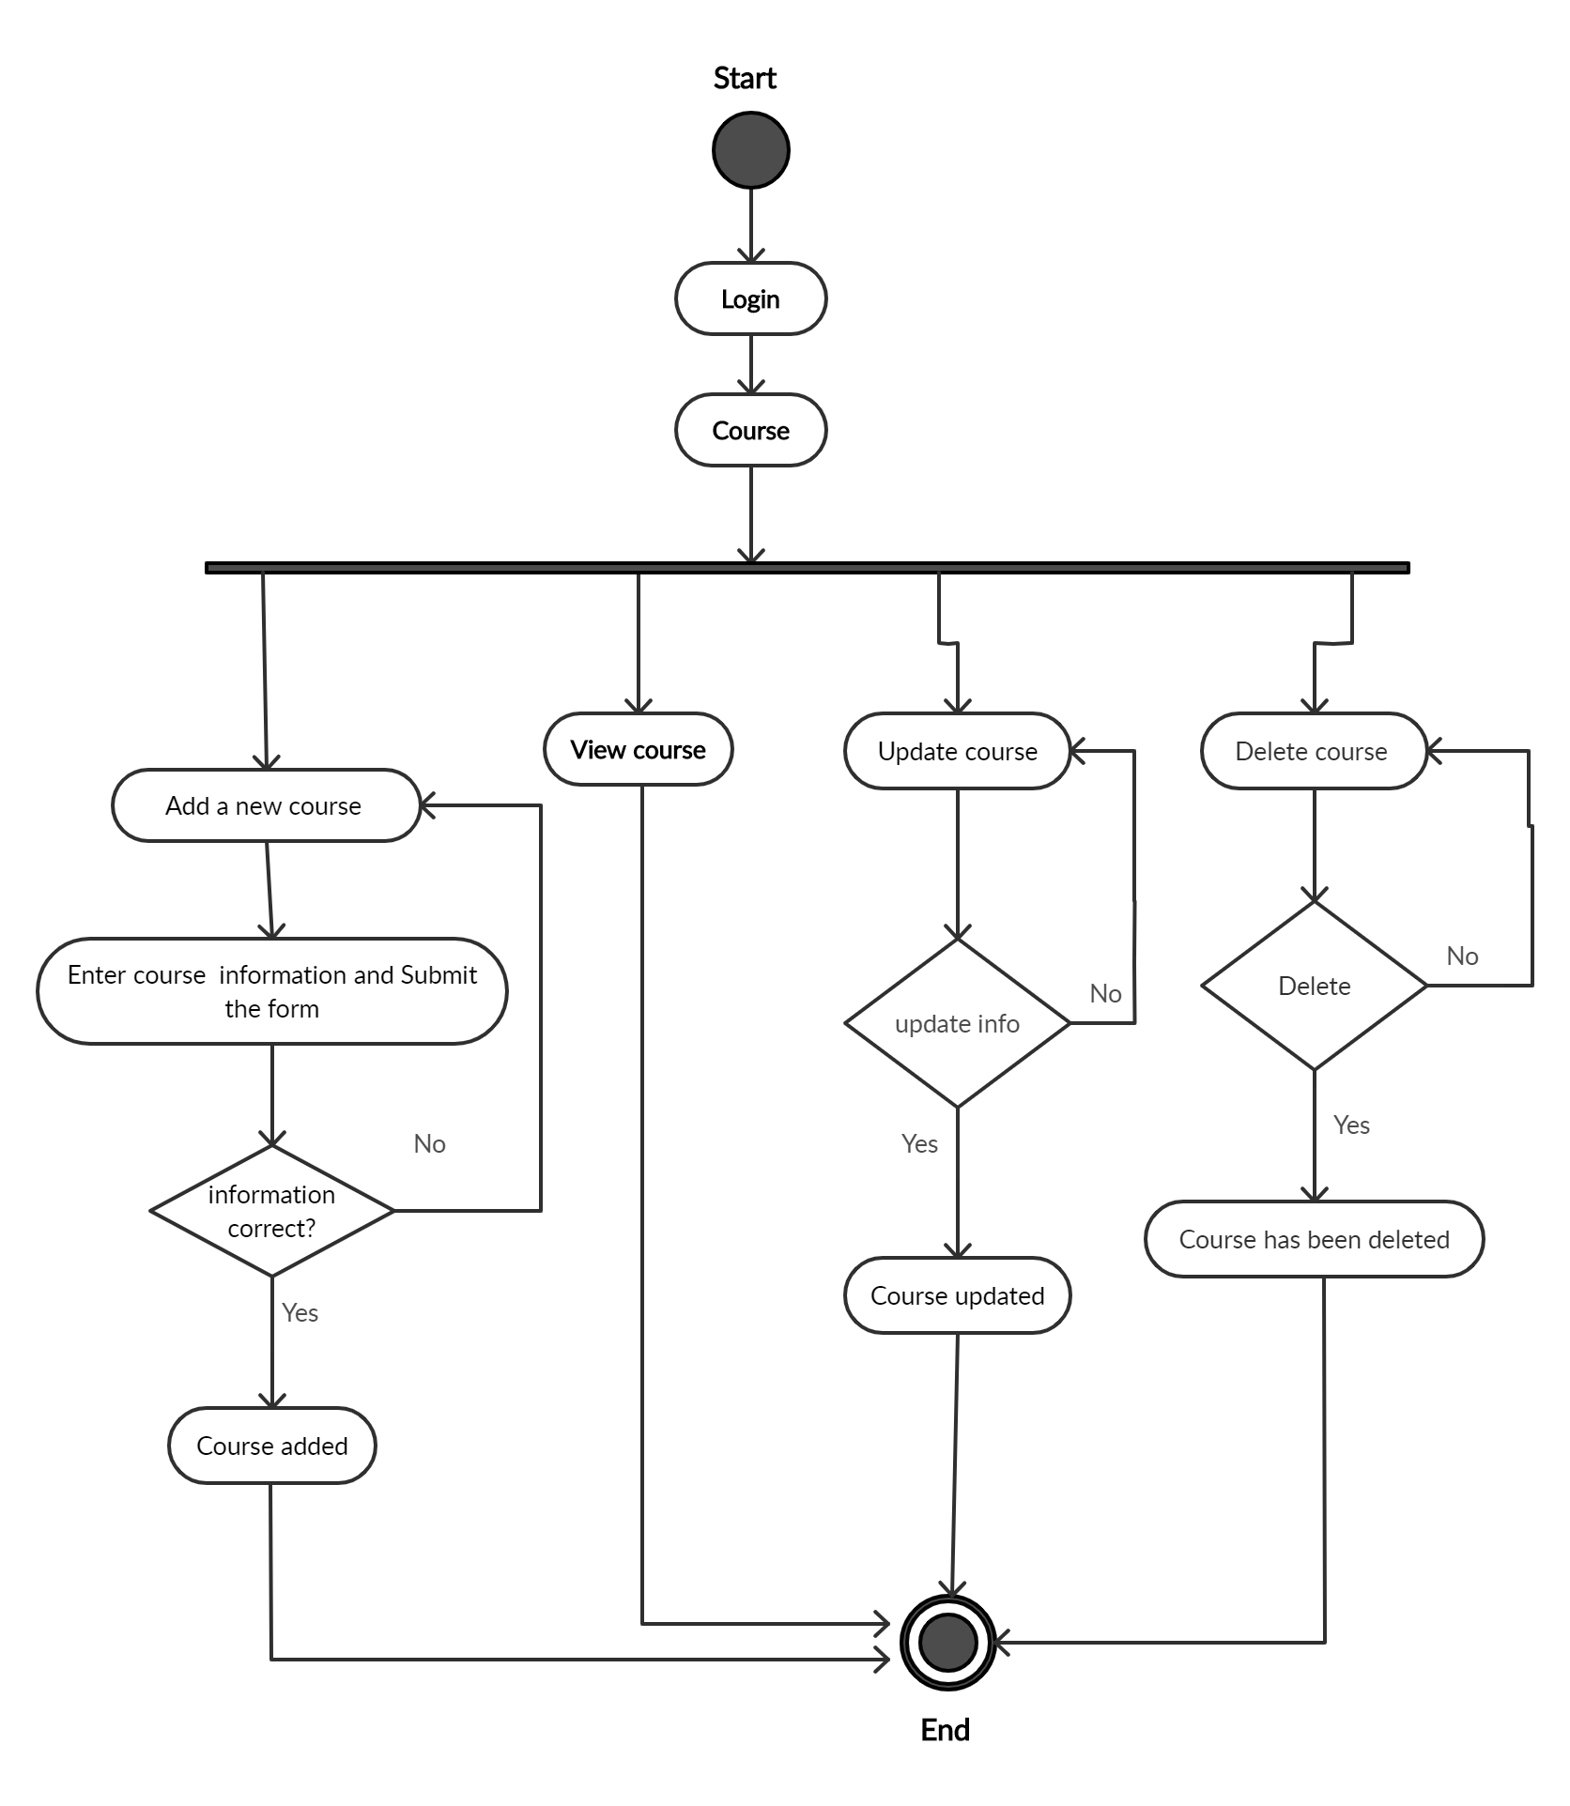
Activity Diagram
11
2.6 fig: Manage Course

Slide 12
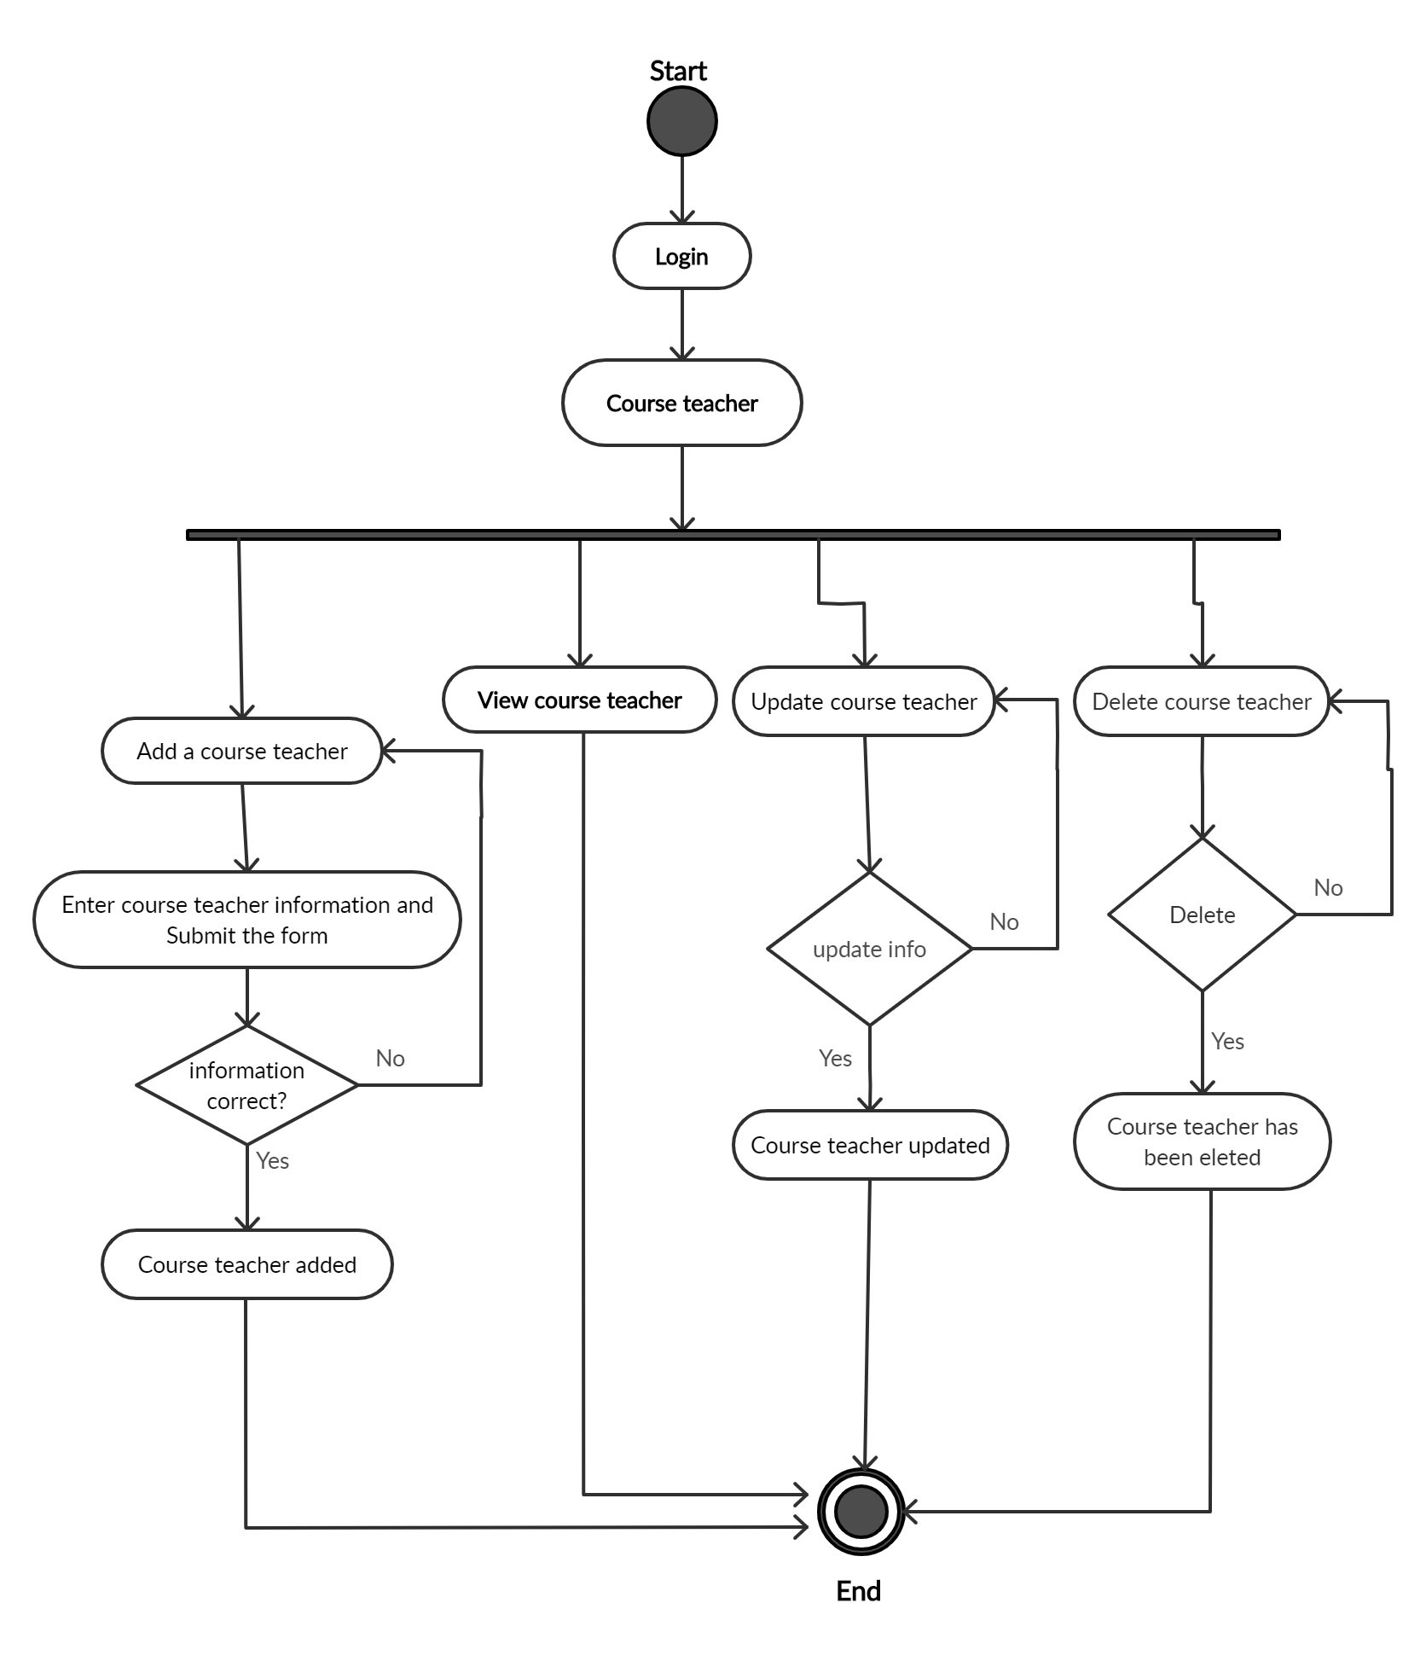
Activity Diagram
12
2.7 fig: Manage Course Teacher

Slide 13

Activity Diagram
13
2.8 fig: Manage classes

Slide 14
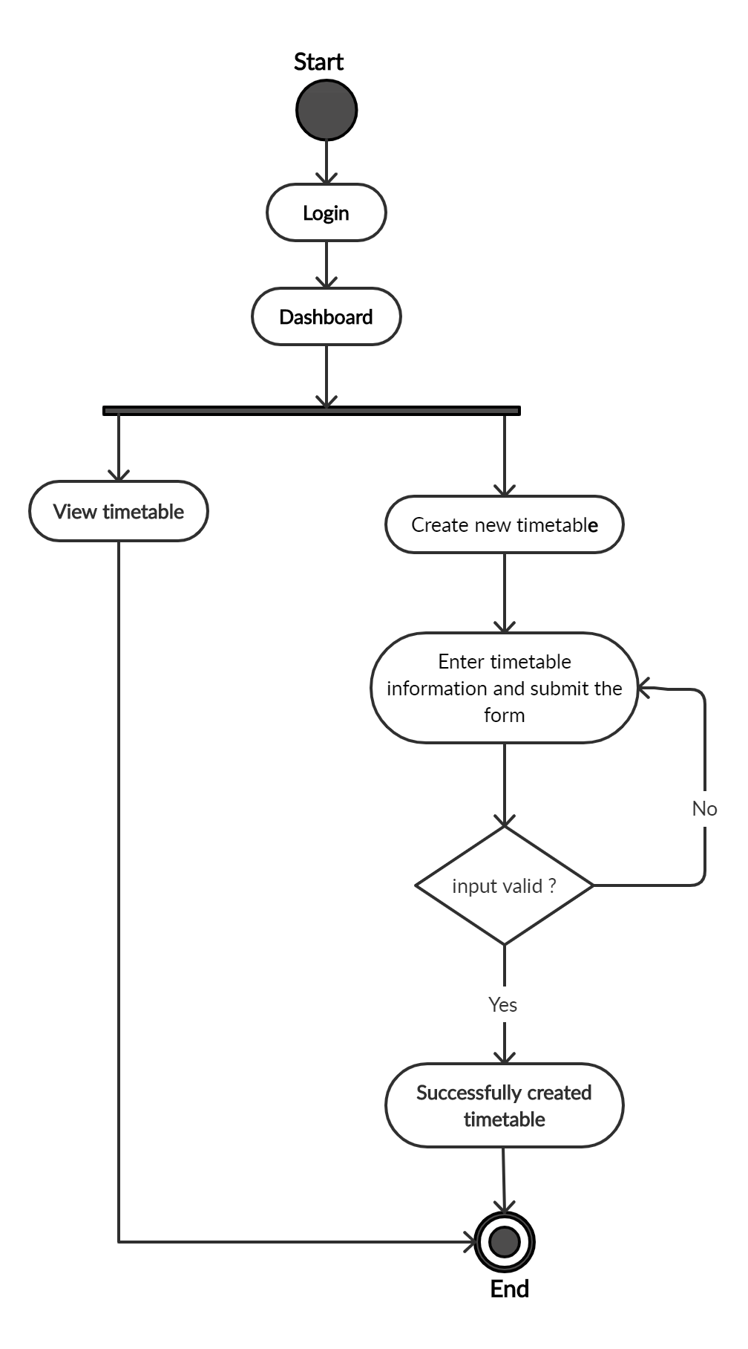
Activity Diagram
14
2.9 fig: View Timetable

Slide 15
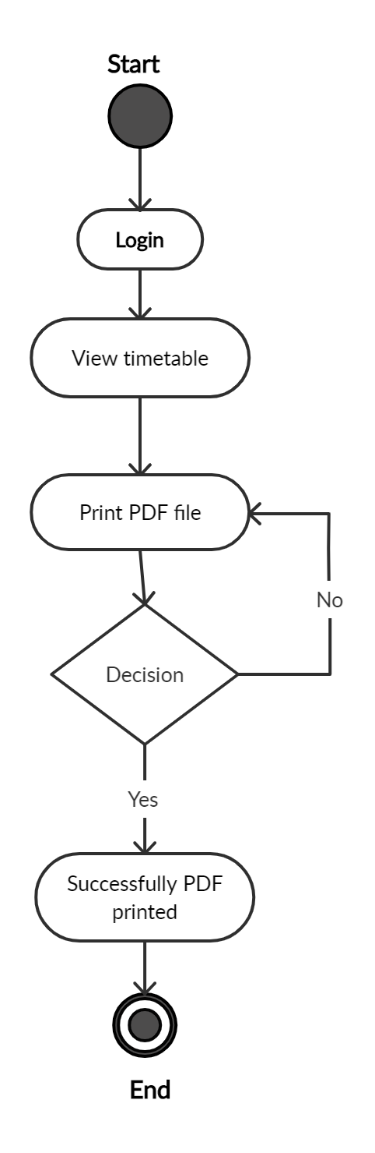
Activity Diagram
15
2.10 fig: Print PDF

Slide 16
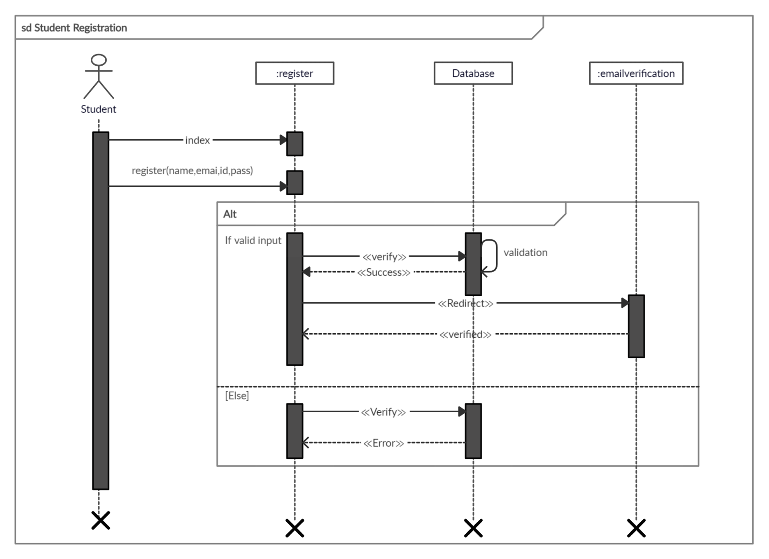
3. Sequence Diagram
3.1 fig: Student Registration
16

Slide 17
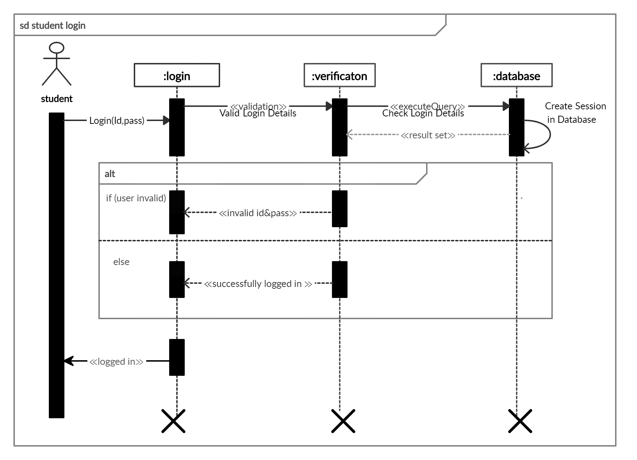
Sequence Diagram
3.2 fig: Student login
17

Slide 18
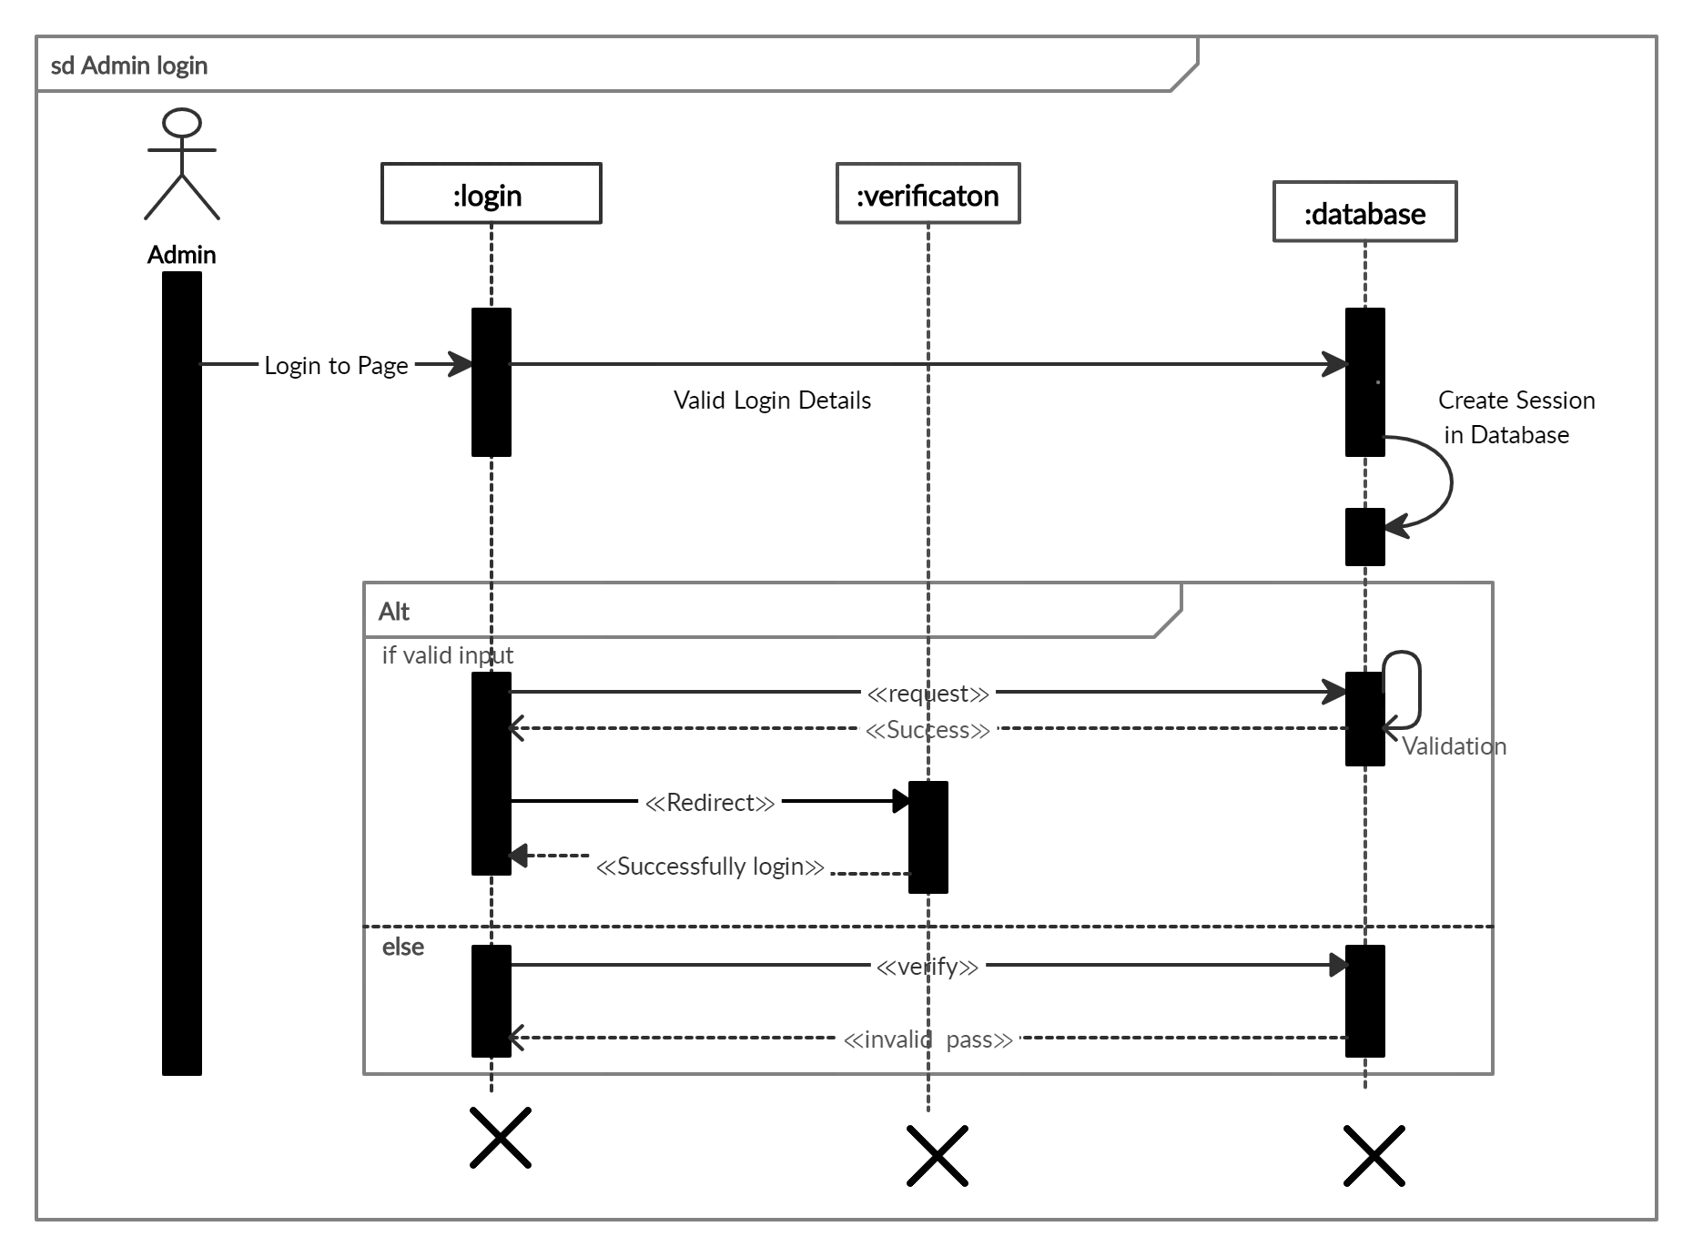
Sequence Diagram
3.3 fig: Admin login
18

Slide 19
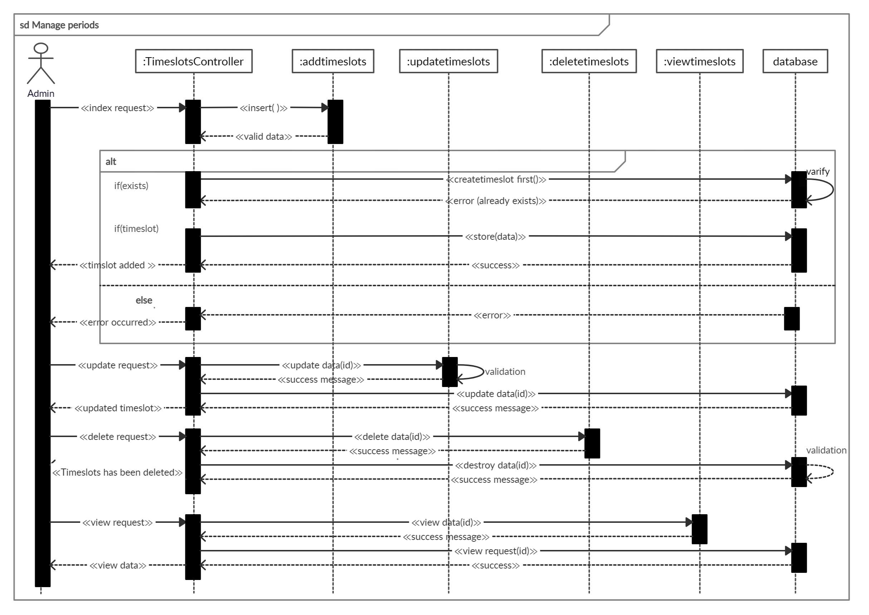
Sequence Diagram
19
3.4 fig: Manage periods

Slide 20
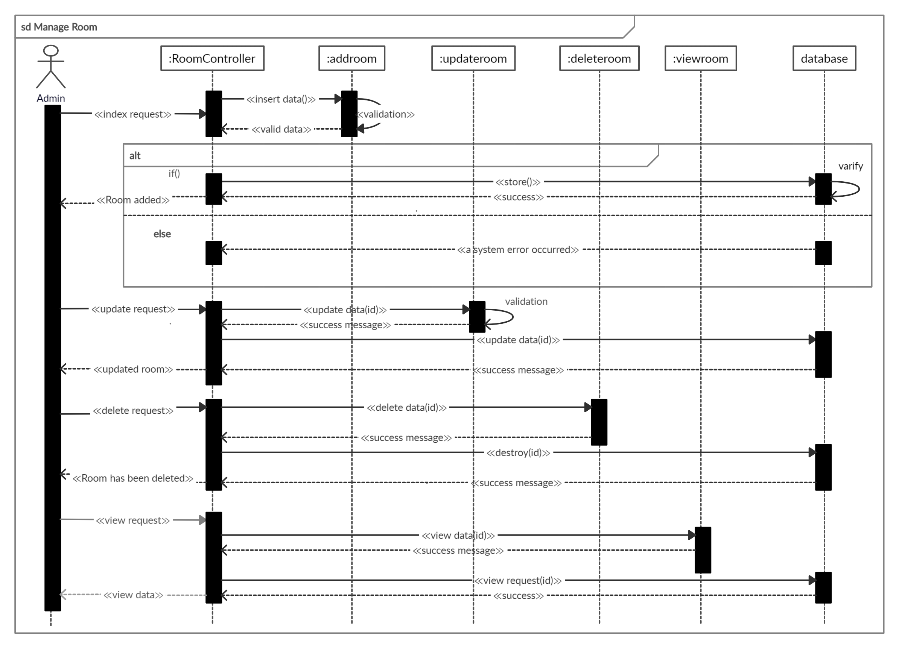
Sequence Diagram
20
3.5 fig: Manage Rooms

Slide 21
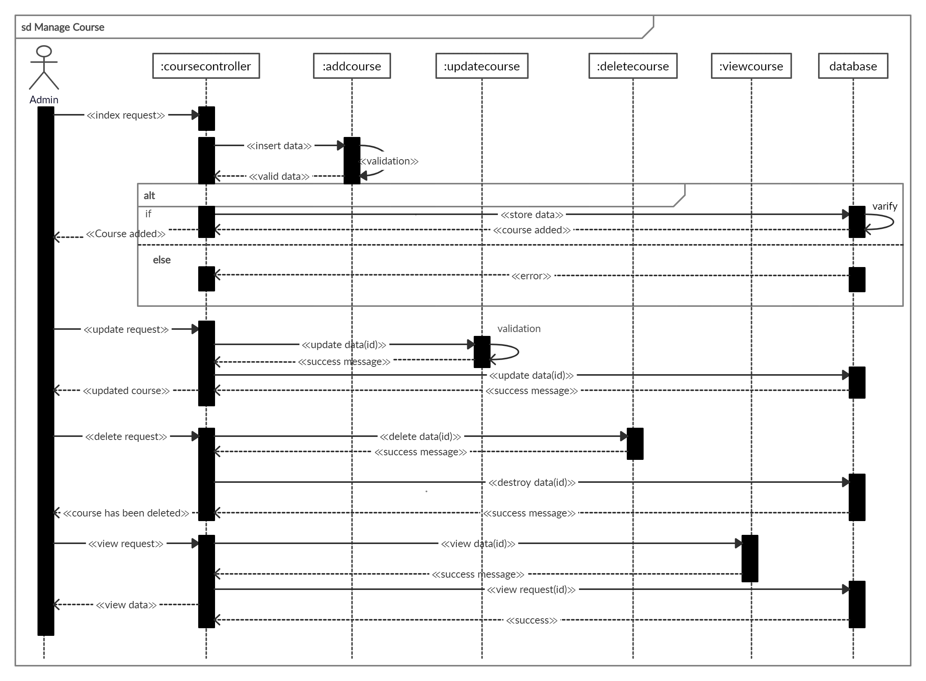
Sequence Diagram
21
3.6 fig: Manage Courses

Slide 22
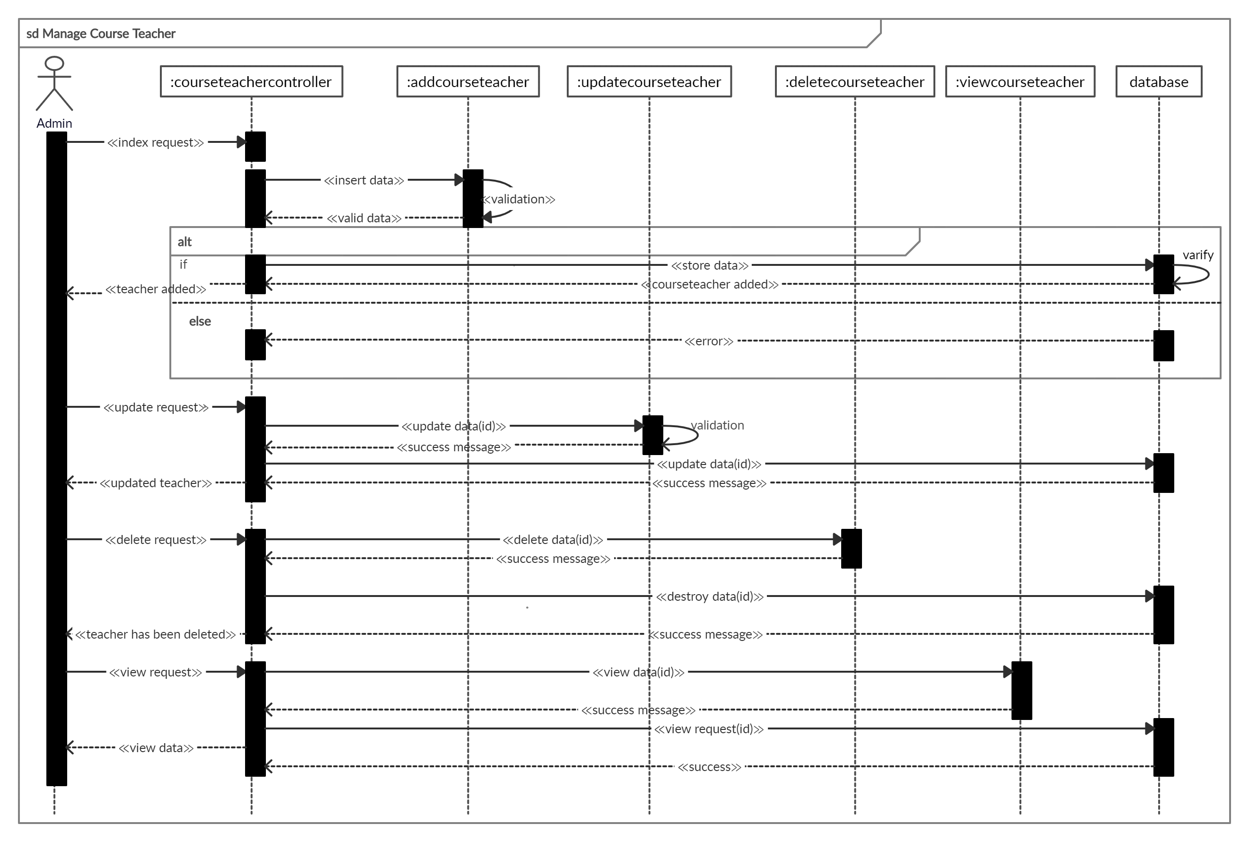
Sequence Diagram
22
3.7 fig: Manage course teacher

Slide 23
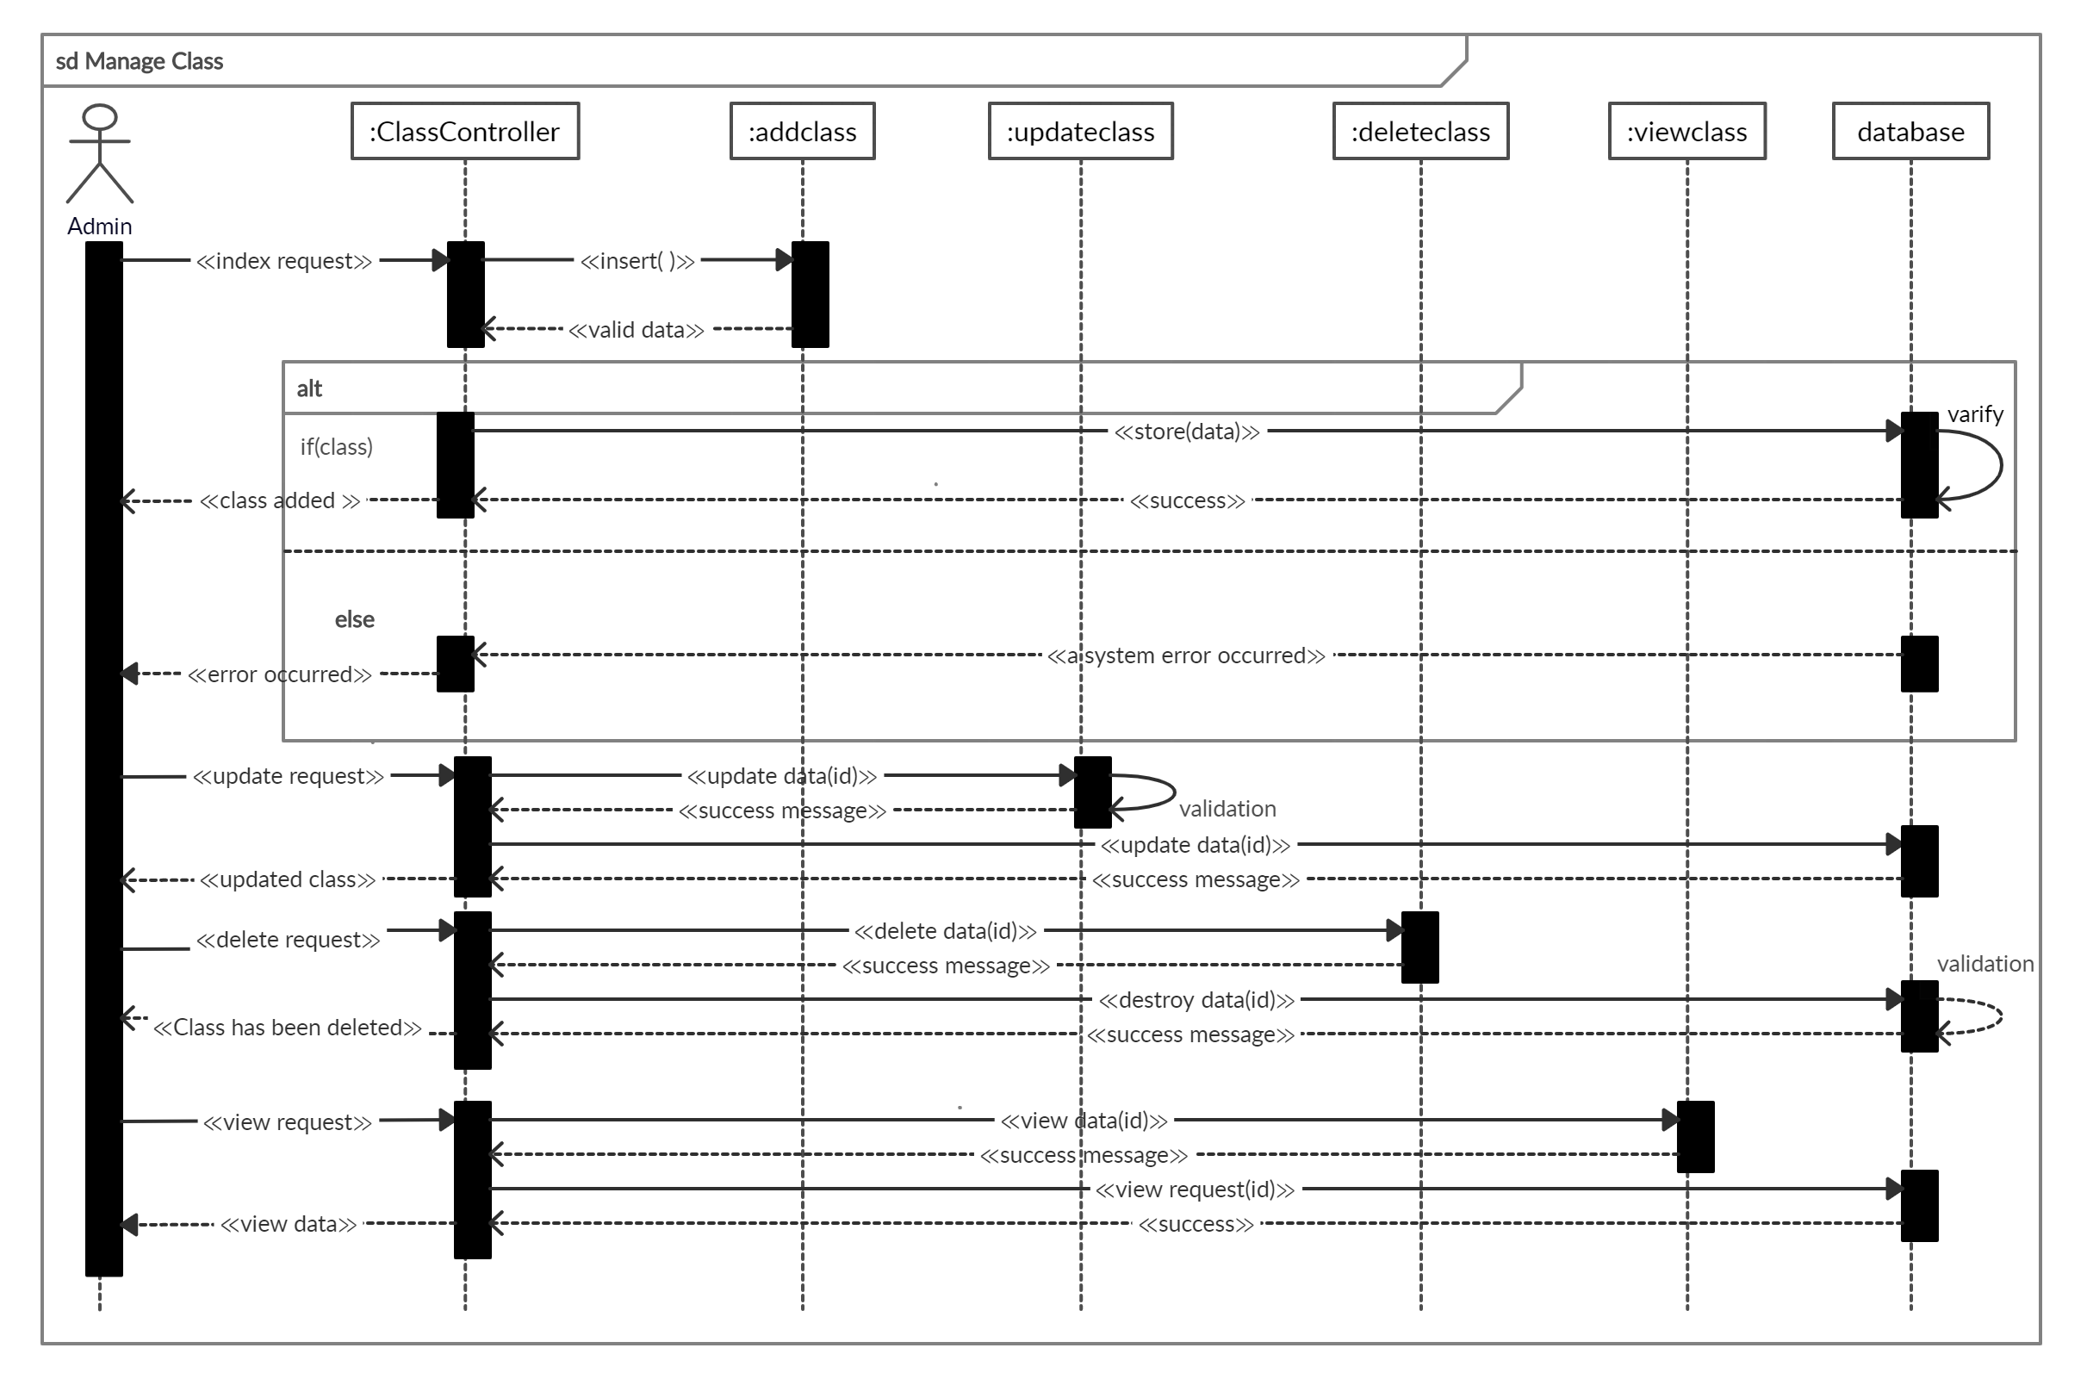
Sequence Diagram
23
3.8 fig: Manage Classes

Slide 24
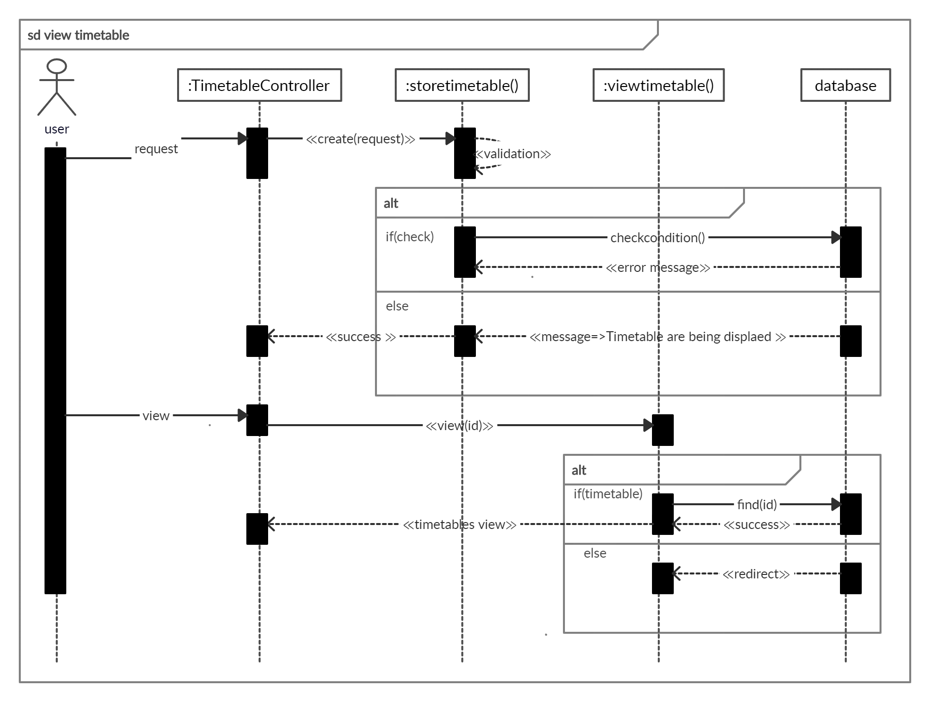
Sequence Diagram
24
3.9 fig: view Timetable

Slide 25
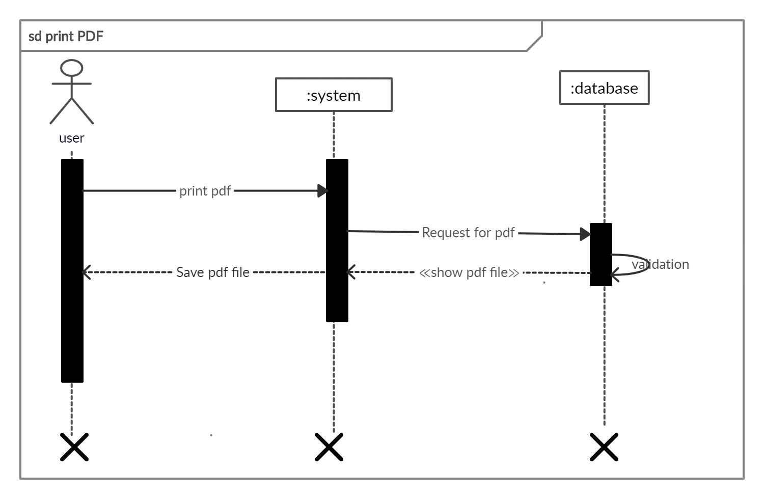
Sequence Diagram
3.10 fig: Print PDF
25

Slide 26
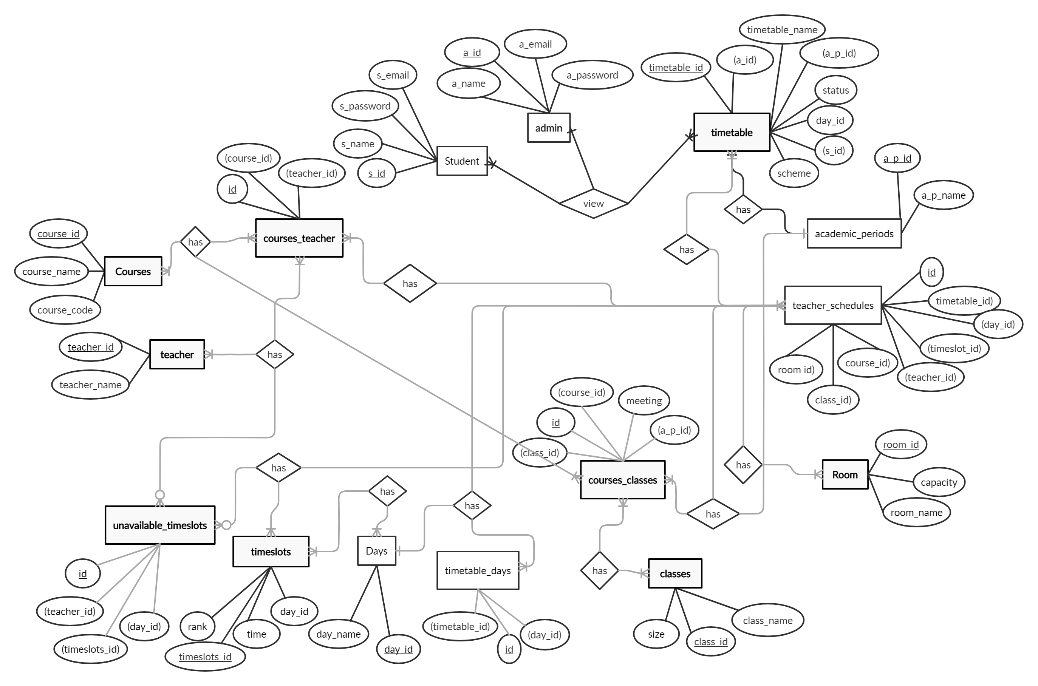
4. Entity Relation Diagram
26
4. fig: ERD

Slide 27

THANK YOU

